Slide 1






Responsibility and liability of scientists: the case of the L’Aquila earthquake
INGV
Massimo Cocco
Istituto Nazionale di Geofisica e Vulcanologia
"ESF-COST Conference on Understanding Extreme Geohazards The Science of the
Disaster Risk Management Cycle Sant Feliu de Guixols, Spain, 27 November - 2 December 2011

Slide 2
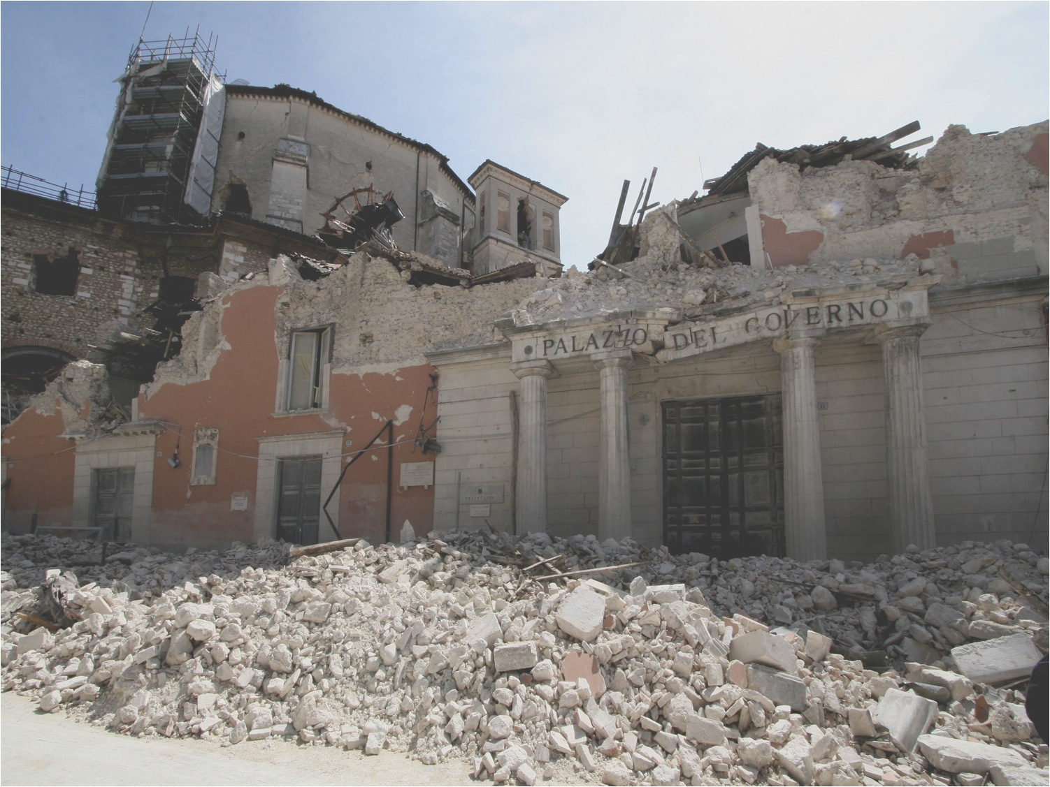
Talking Points
INGV
Lessons from recent earthquakes
Science for Society: from understanding to increasing resilience to natural hazards
The L’Aquila 2009 earthquake case:
  What scientists knew
  What we did
  The responsibility and likability issues
  The real missed lessons
Notes:
In my opinion the approach to properly address the key objectives of this program is really interdisciplinary. A relevant example is represented by vulnerability assessment, which involves at least three distinct communities: seismologists, earthquake engineering and social scientists dealing with physical, systemic or social vulnerability.

Slide 3
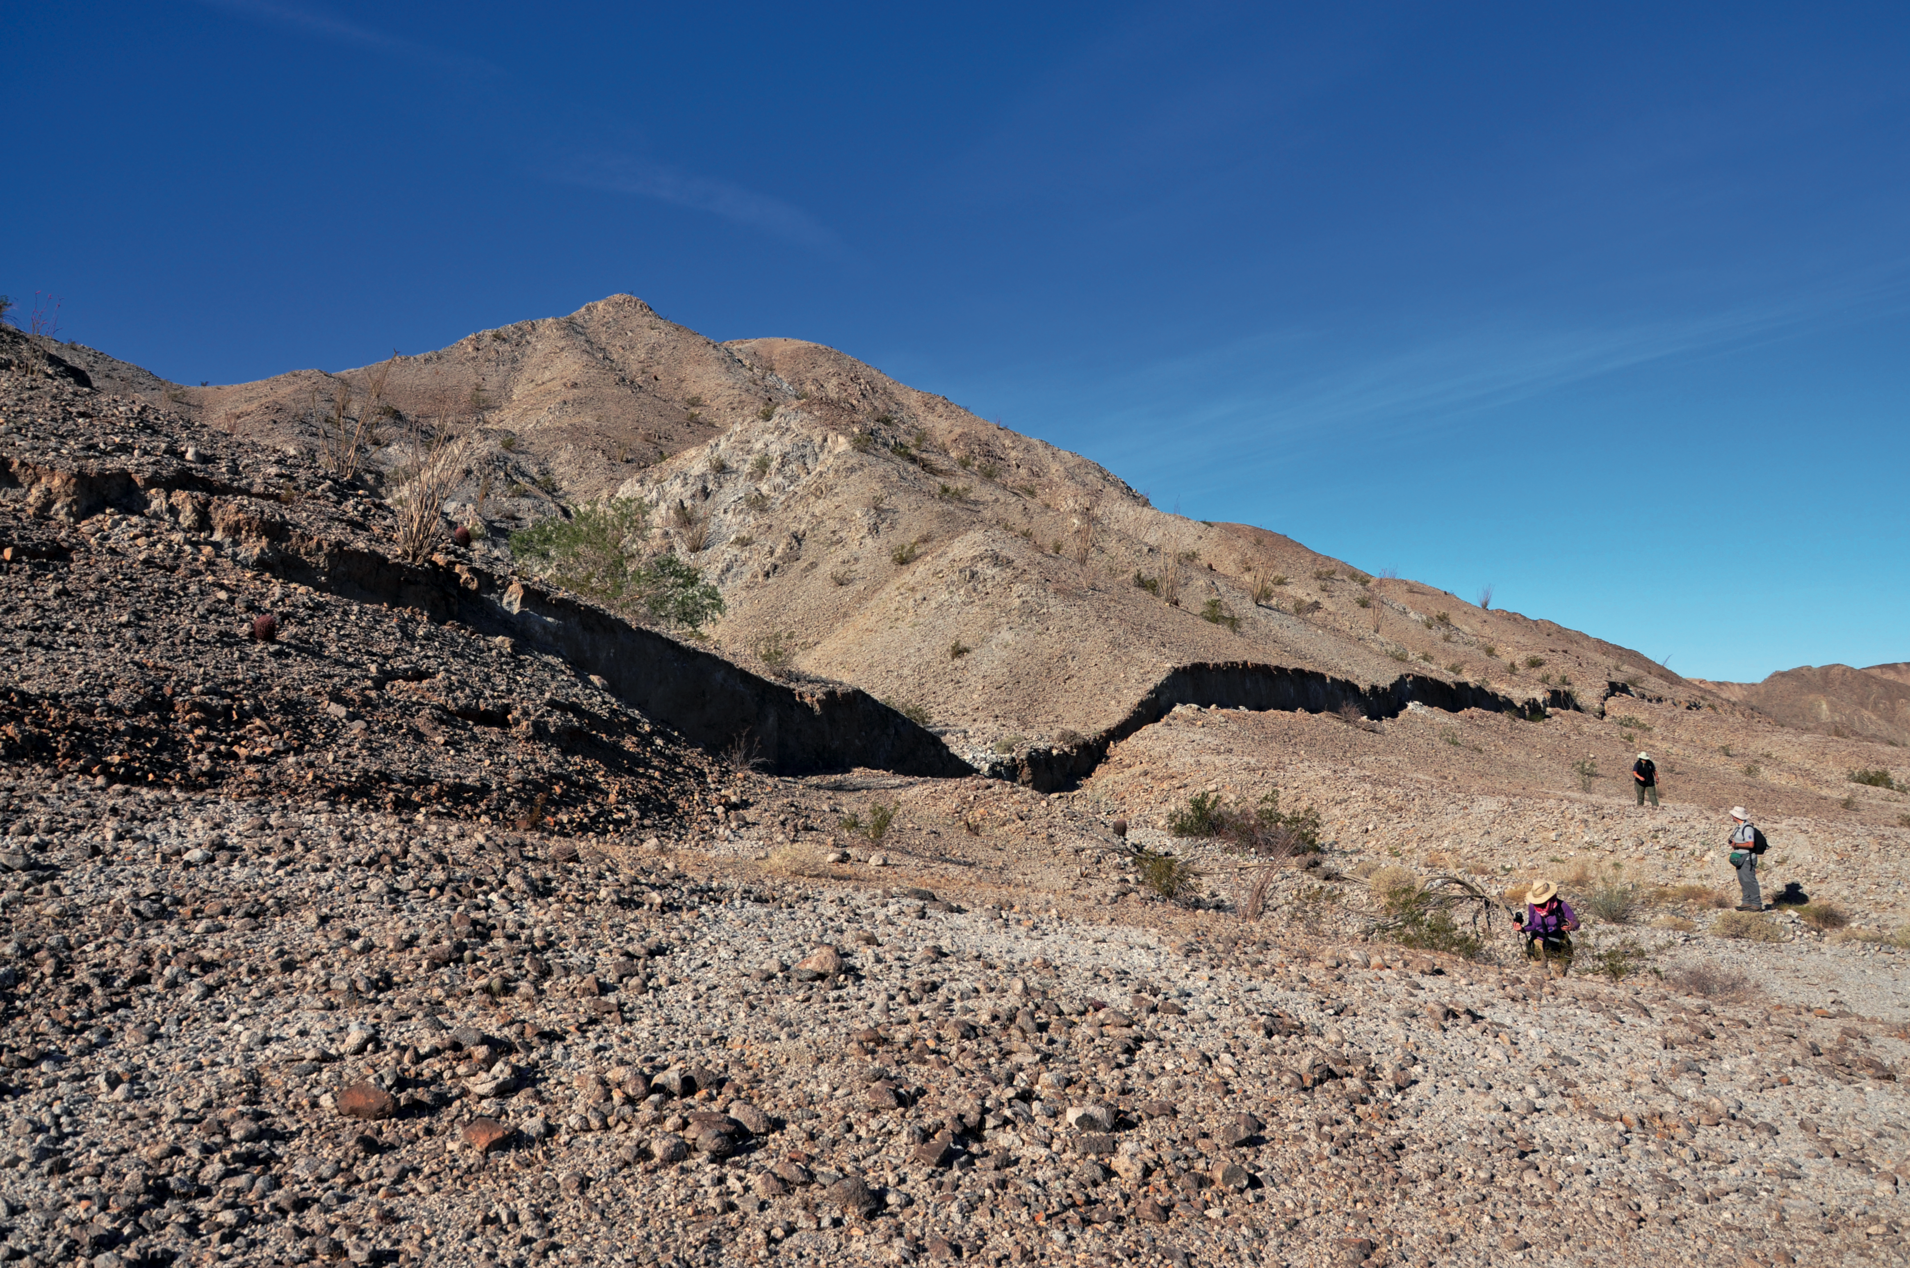
Lessons from recent earthquakes
INGV
Sumatra M 9.3 (Indonesia) 2004
L’Aquila M 6.1 (Italy) 2009
Haiti M 7.0 2010 (Caribbean)
Maule M 8.8 (Chile) 2010
Christchurch M 7.2 (New Zealand) 2010
Tohoku M 9.0 (Japan) 2011
Virginia M 5.8 (USA) 2011
Notes:
We have discussed several times in this conference these earthquakes and their impact on the scientific community and the society. I believe we can summarize the following lessons that we can learn from these earthquakes.
the impact on society was independent of their preparedness
the resilience of involved communities is independent of economic classification between developing and developed countries
Actions to involve stakeholders and to increase resilience in these regions of the world are different

Slide 4
Science for Society: from understanding to increasing resilience to natural hazards
INGV

Slide 5
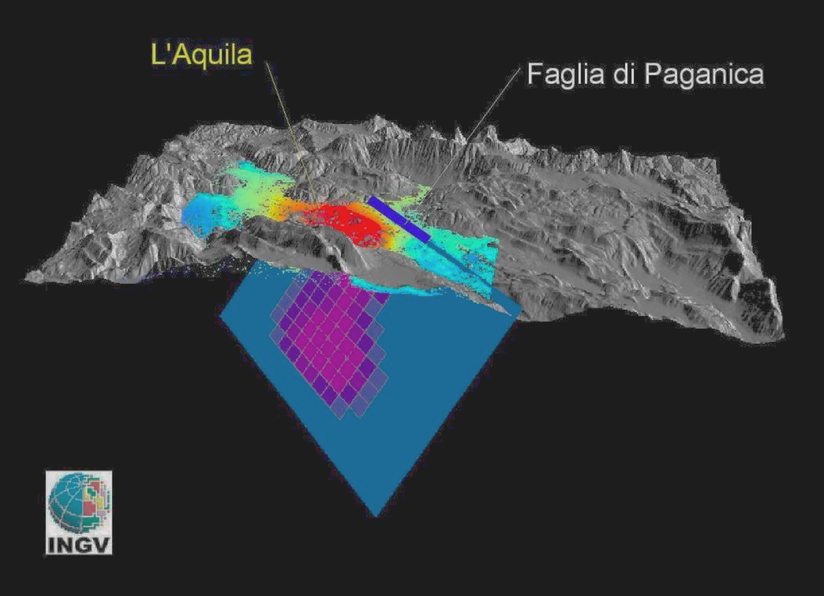
The April 2009 L’Aquila main shock
April 6th 2009 M_{w} 6.3 at 03:32 am
High quality monitoring RIs
Vulnerability was known
Revised hazard map
An unprecented data set
for aftershocks
High complexity of involved
coseismic processes

Slide 6
A retrospective discussion
INGV
Time window
Data, Interpretations & Actions

Slide 7
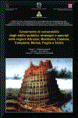
Time Window 1: 1990-2008
INGV
What we knew
Seismic hazard for the region (updated in 2004)
Probability of occurrence of a M 5+ earthquake was relatively high (≈10-15%, at 10 & 50 years) [Pace et al., 2006; Faenza et al., 2003; Cinti et al., 2006]
Vulnerability of several building and historical heritage in L’Aquila city was known [GNDT-LSU, 1999; SIGOIS, 2006]
Historical seismicity and active strain indicate high earthquake potential
There were several seismic sequences in the area with main shocks M ≅ 4 not followed by any destructive event (i.e., 1985)
Censimento di vulnerabilità degli edifici pubblici strategici e speciali nelle regioni Abruzzo,
Basilicata, Calabria, Campania, Molise, Puglia e Sicilia Orientale,

Slide 8
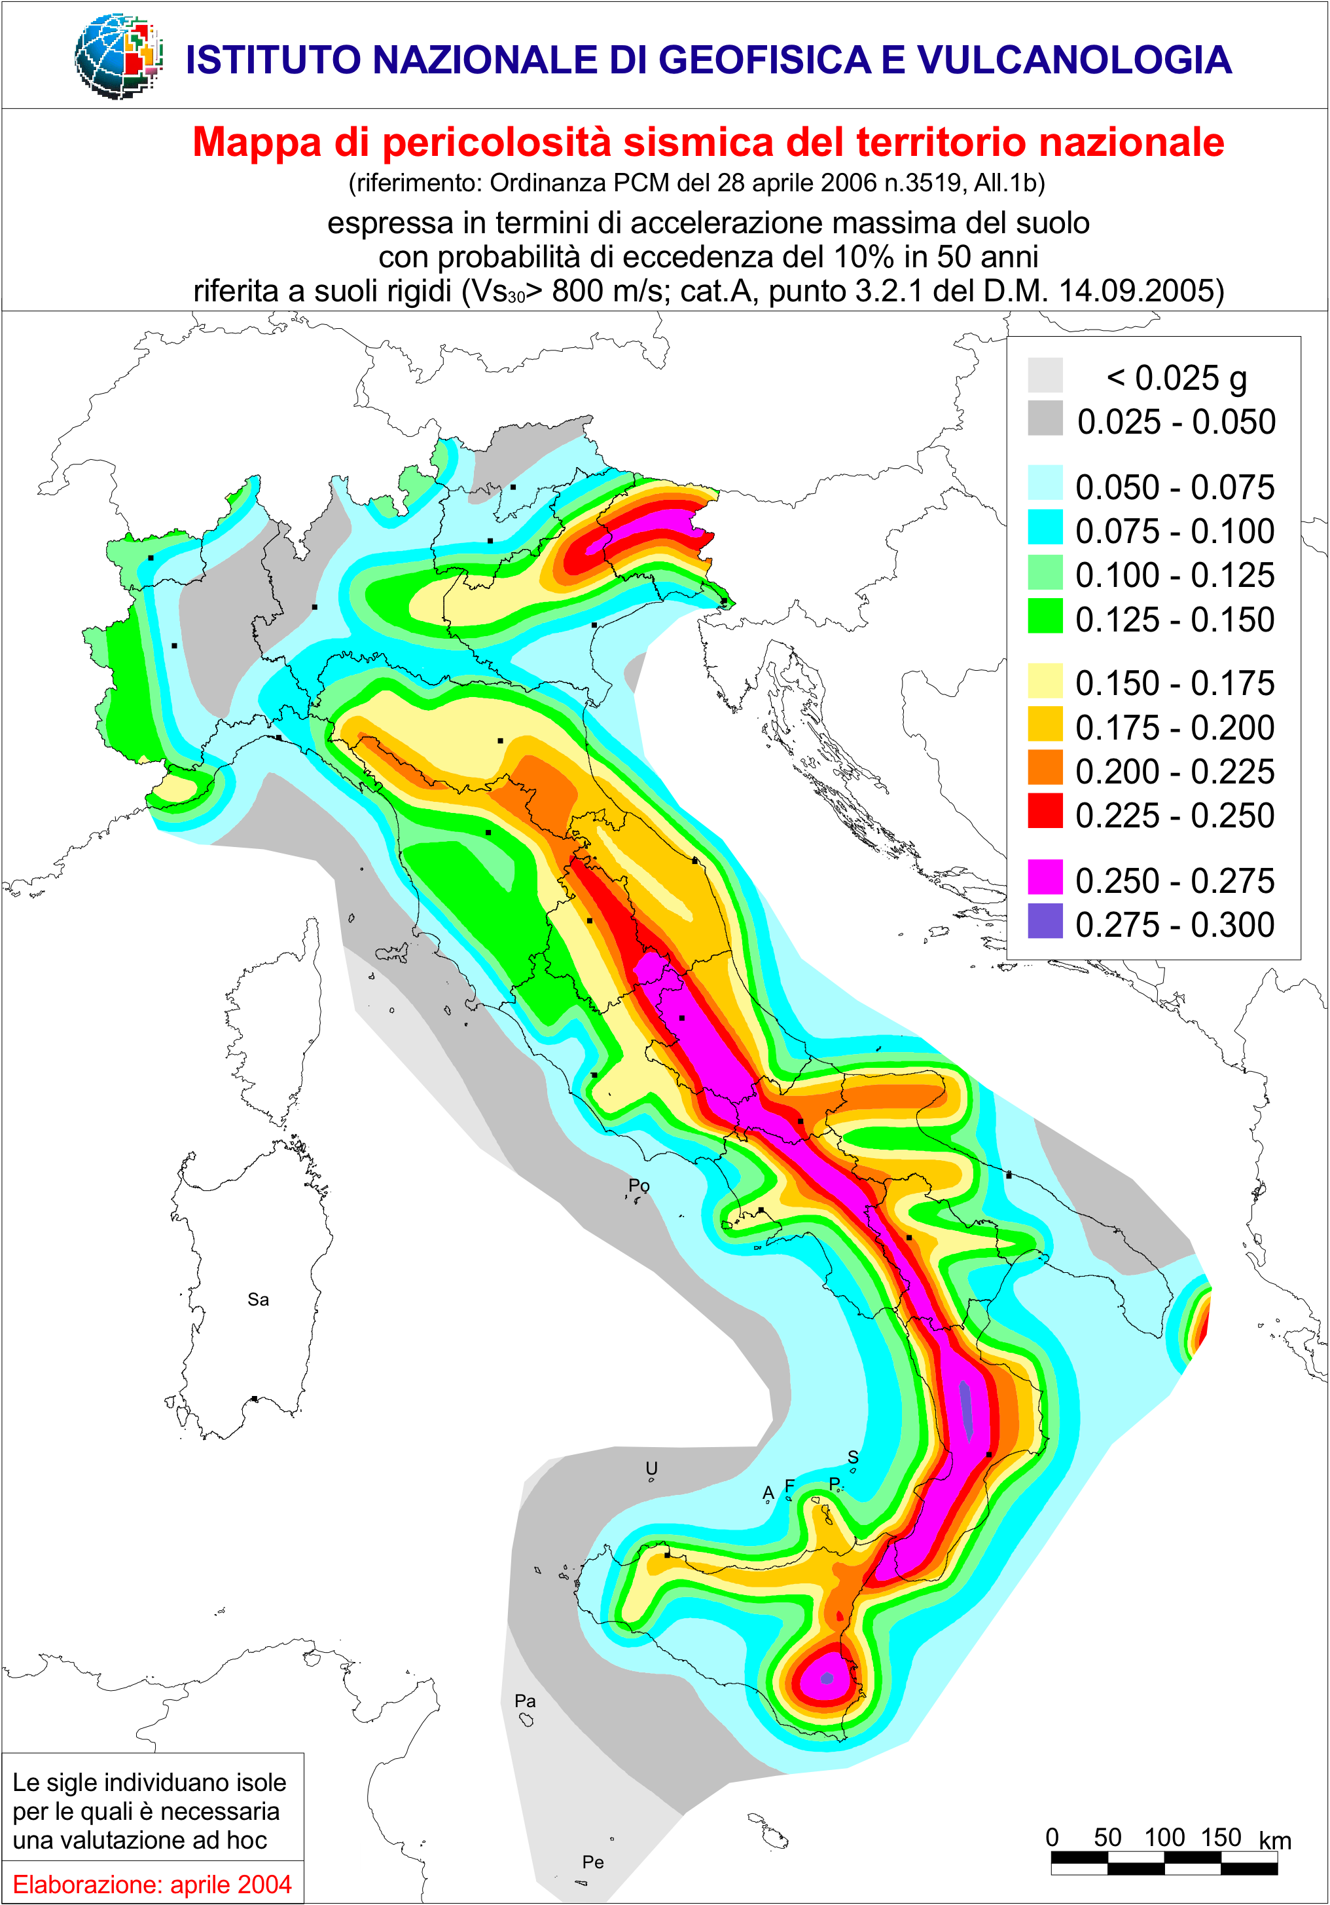
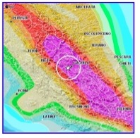
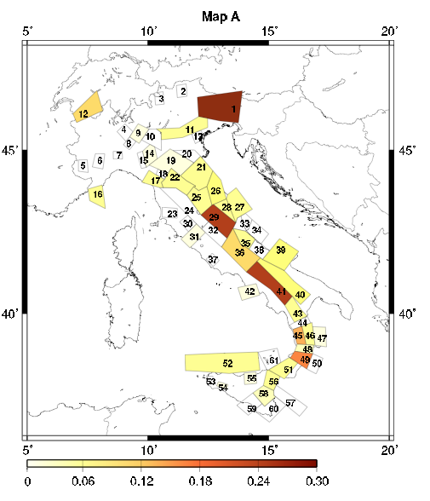
Time Window 1: 1990-2008
INGV
The seismic hazard map of Italy (2004)
L’Aquila has
been classified
as high hazard
since 1915 !!!
Faenza et al., (2003)
Pace et al., (2006)
Cinti et al., (2004)

Slide 9
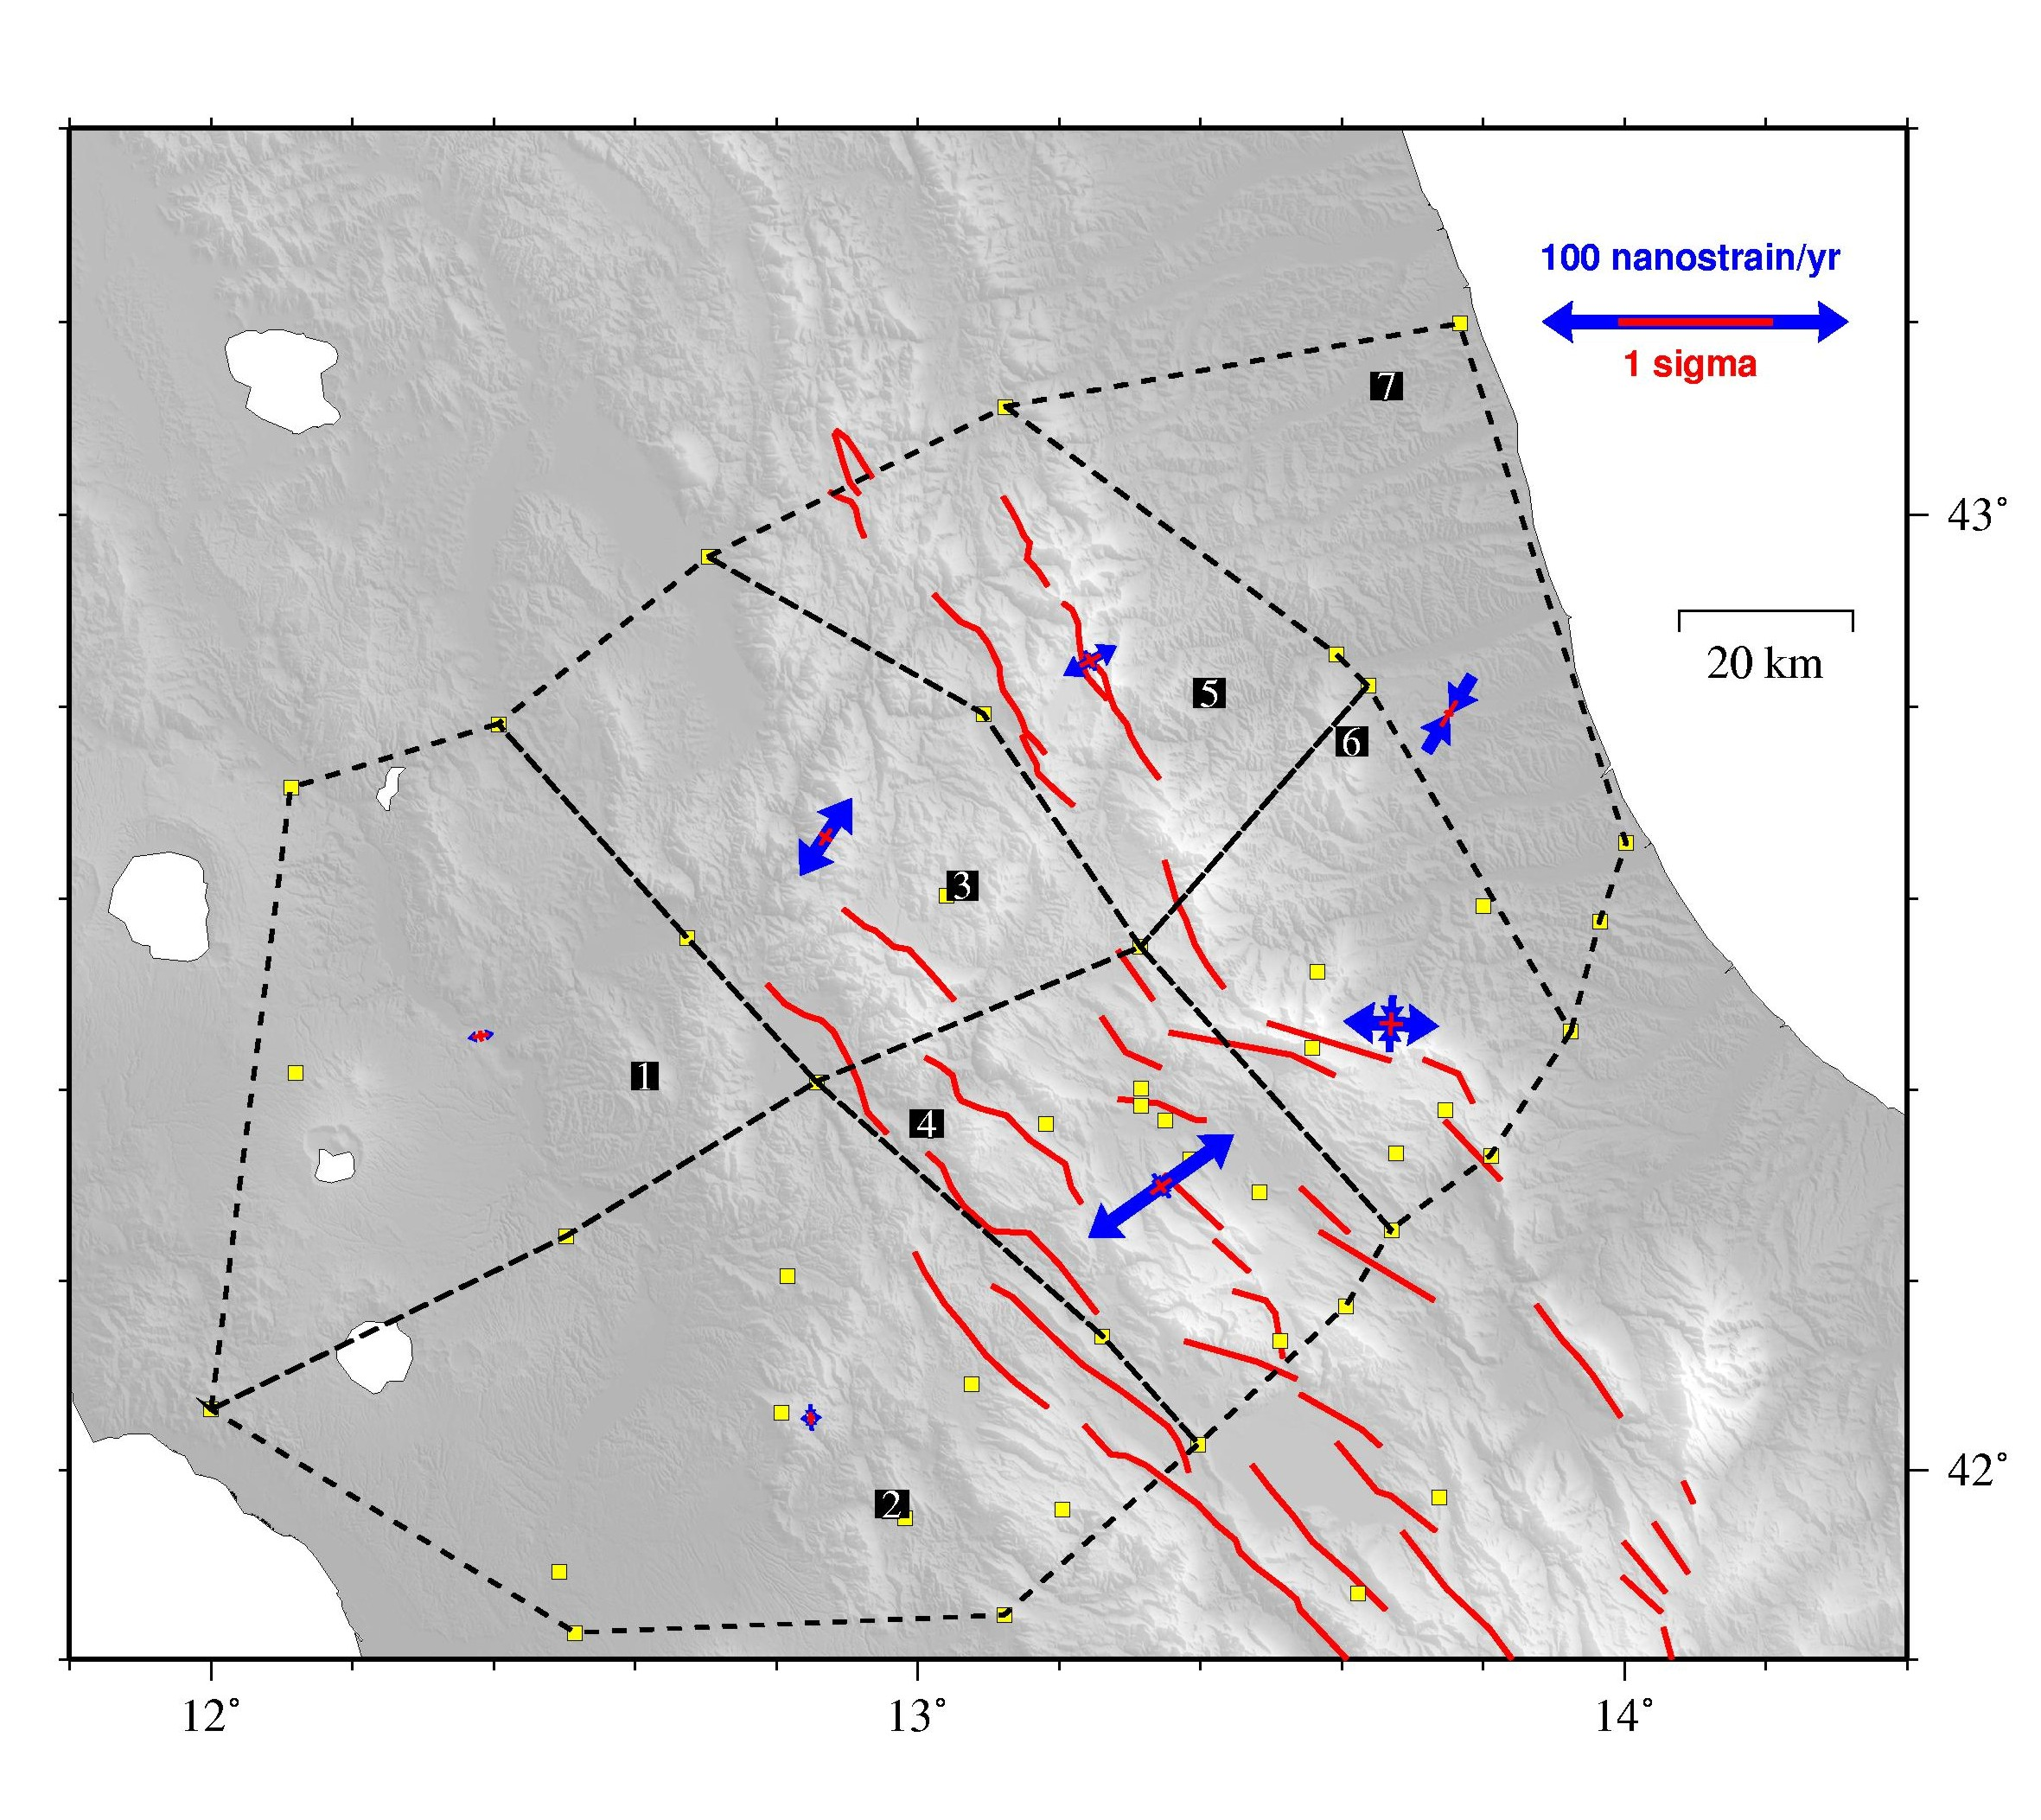
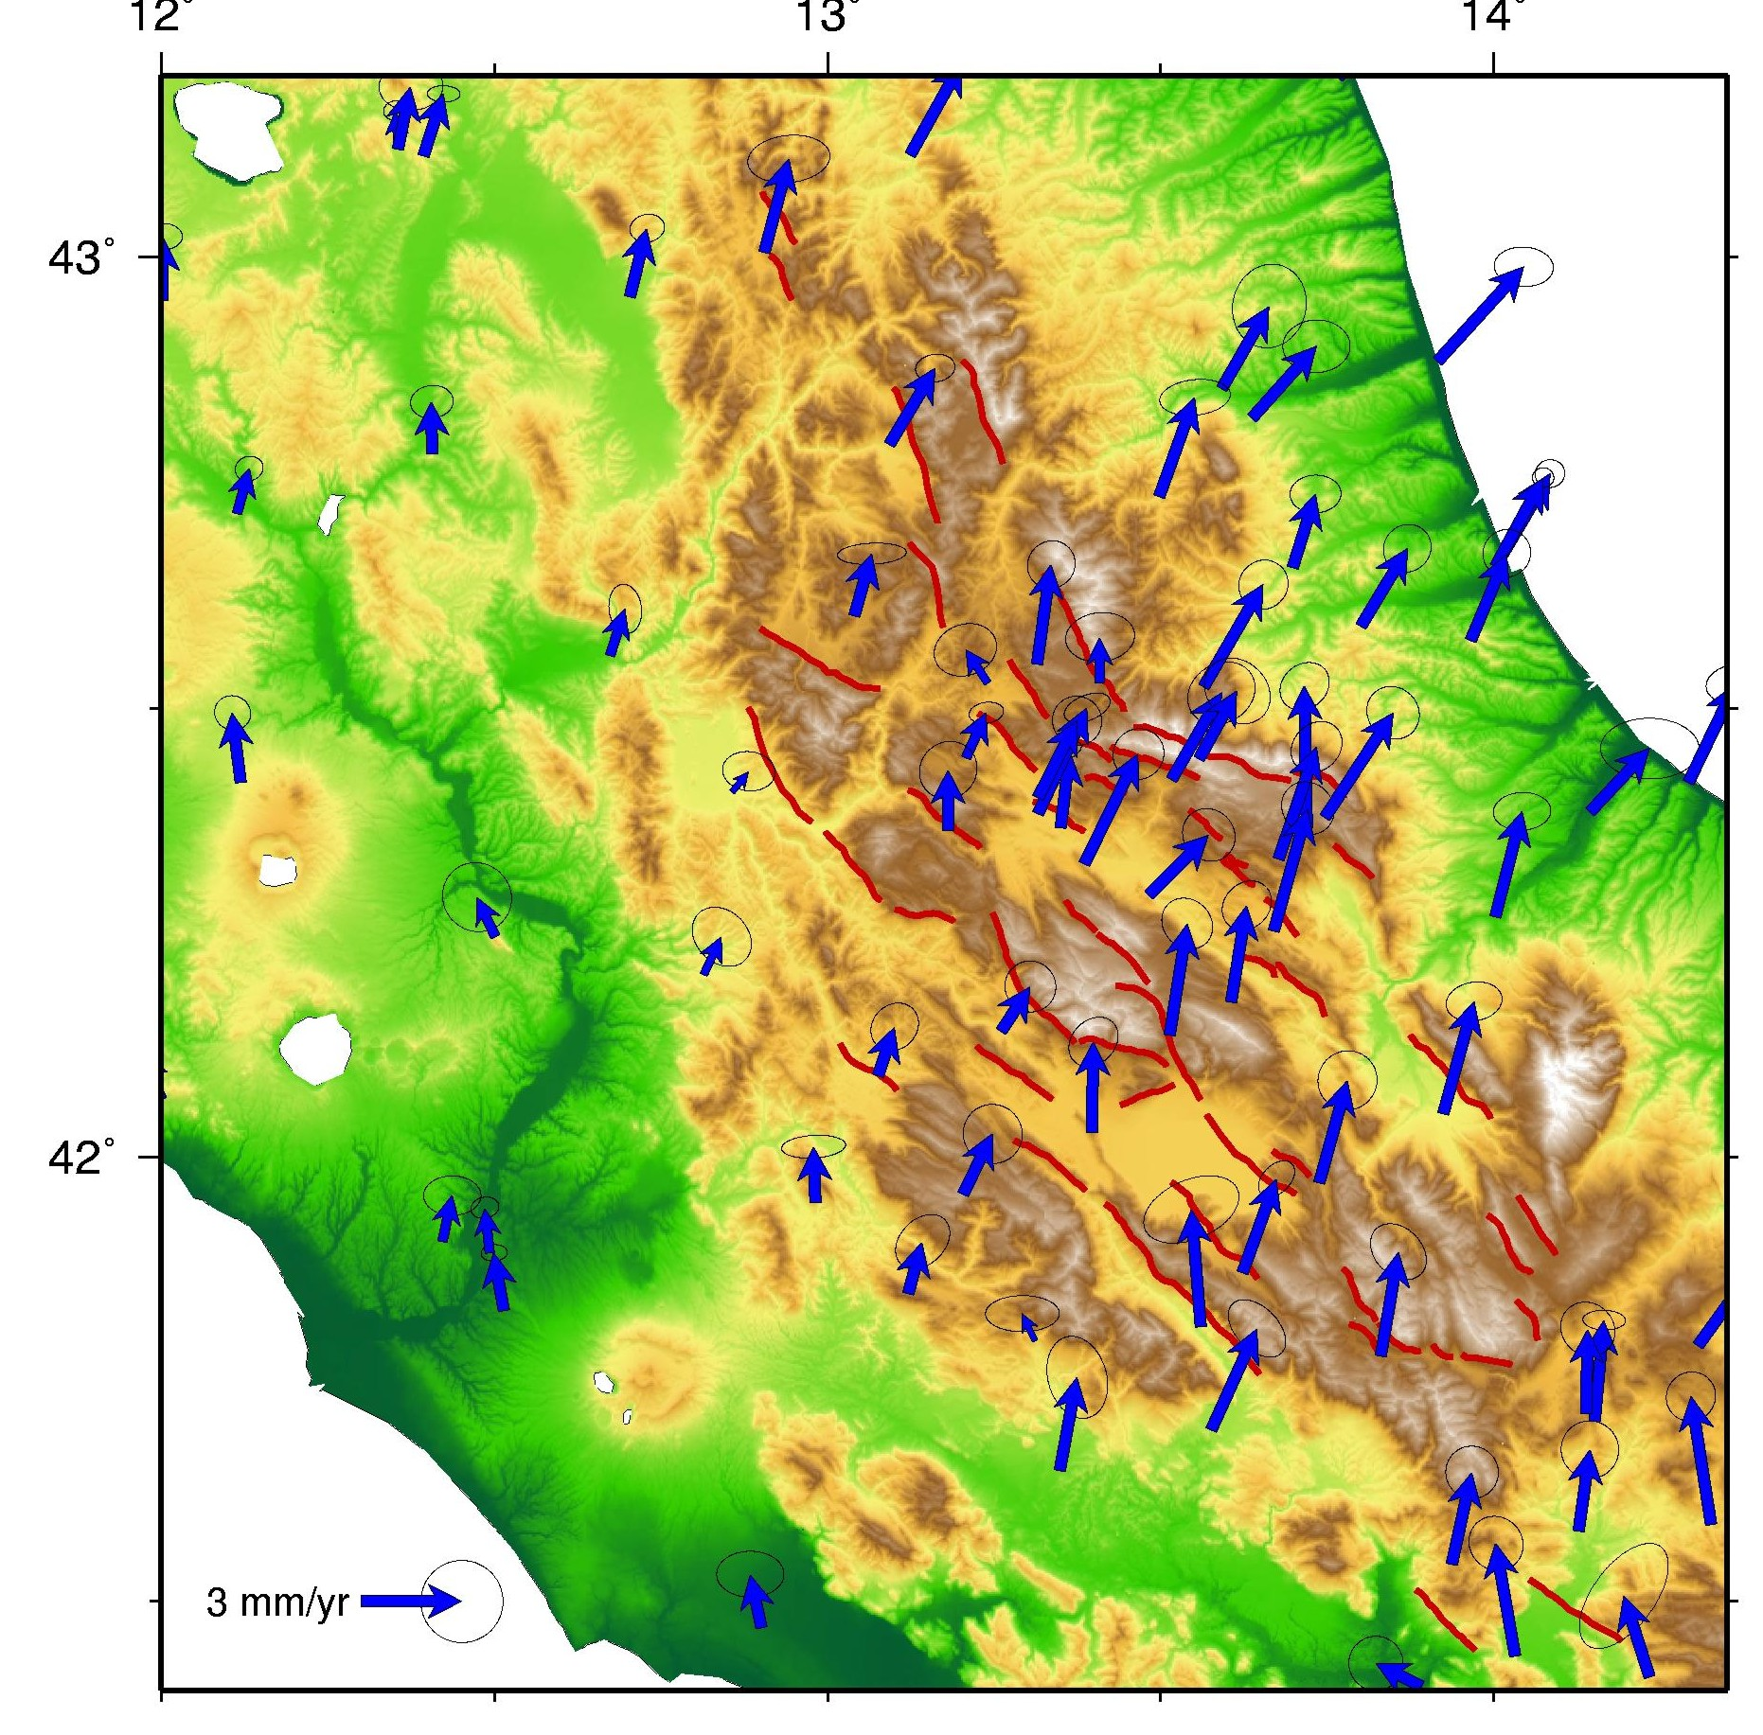
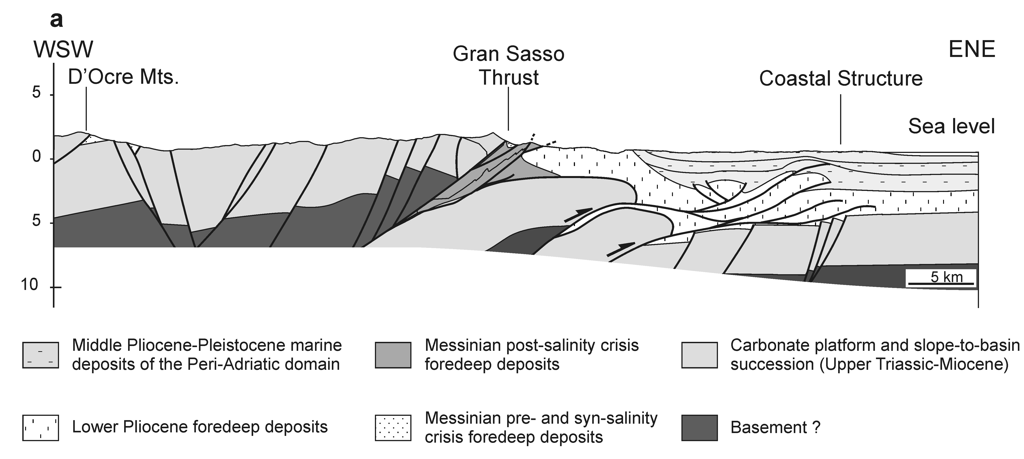
Interseismic strain inferred from GPS
Strain Rate Velocity field
Normal faulting
Schematic geological section
across the M. D’Ocre – Gran Sasso
structures (after Satolli and Calamita 2008)
Notes:
The Abruzzo region is characterized by a relatively higher strain rate and a strong gradient of velocity between the Apennine
chain and the Adriatic coast.

Slide 10
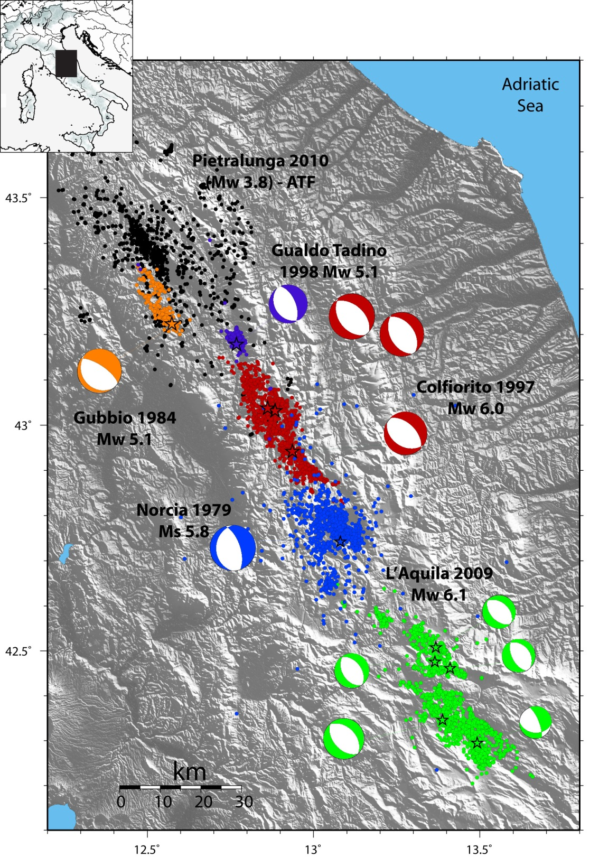
Regional Seismicity
INGV
CSI catalogue
1980-2008
(Chiarabba et al., 2008)
Catalogue of the most
recent seismic sequences
1979-2009
(Chiaraluce et al., 2011)

Slide 11
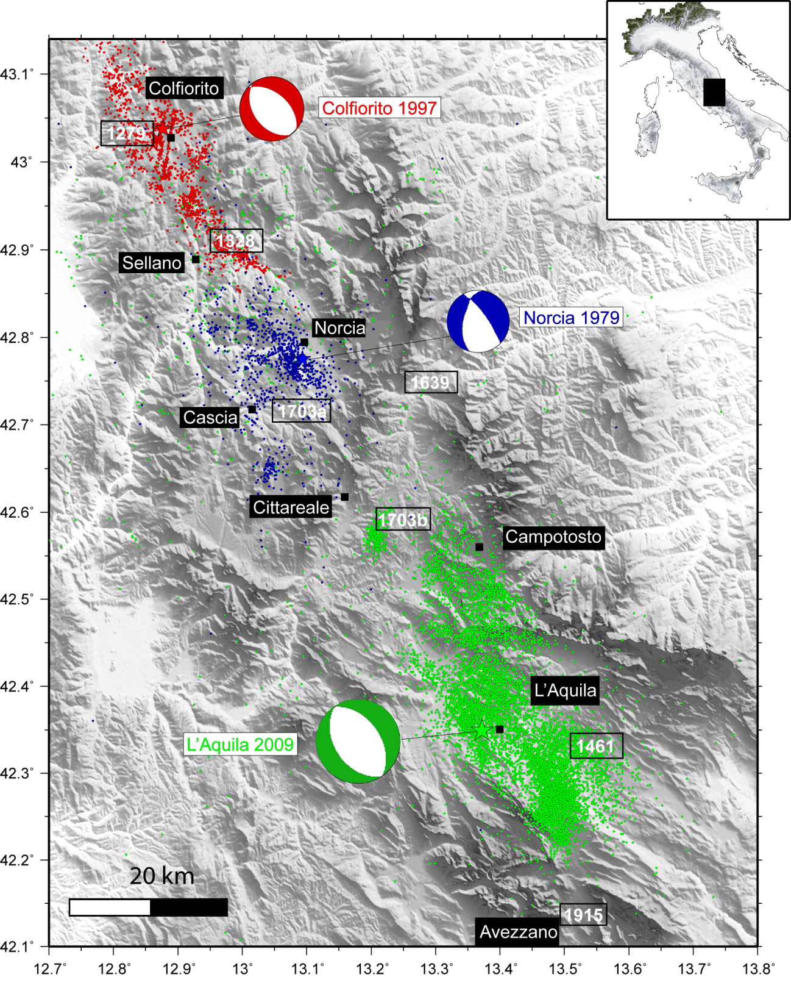
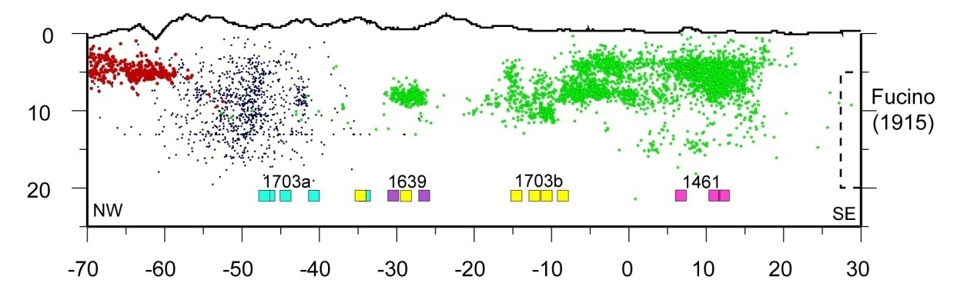
Recent
Seismic
Sequences
INGV
(Chiaraluce et al., 2011)

Slide 12
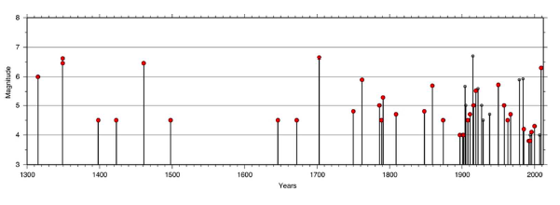
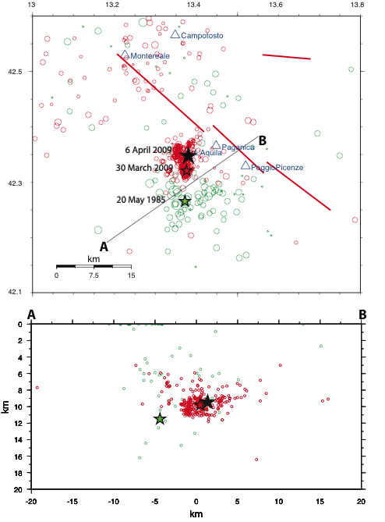
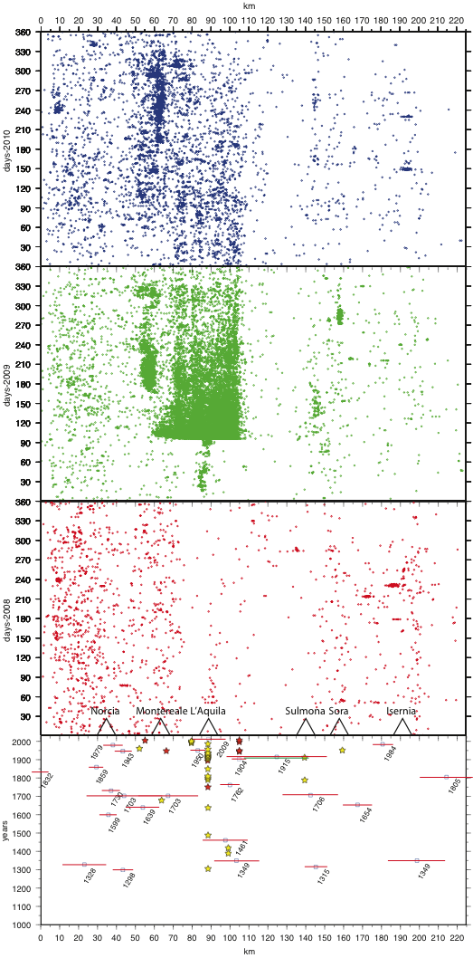
Time Window 1: 1990-2008
INGV
M_{L} 4.2
Previous instrumental &
historical seismicity
Amato & Ciaccio(2011)
Notes:
In the 20th century, at least 23 sequences affected the Abruzzi region, 8of which were very close to L’Aquila. In previous centuries, we found evidence of at least 13 sequences around L’Aquila, with maximum magnitude 4 to 5. Only three sequences were followed by stronger shocks (1461, 1703 and 2009). However, many strong events of the region (1349, 1762, 1915, 1950) were not preceded by foreshocks. We describe here the last of these sequences (1985) showing its strong similarity with the 2009 one,except its final evolution (no large event in 1985). Our analysissuggests that seismic sequences alone cannot be consideredstraight forerunners of incoming strong events

Slide 13
Time Window 1: 1990-2008
INGV
What we did = What we could do now
Scientists provided results and products to assess seismic hazard and vulnerability of the Italian territory
The Italian Civil Protection committed many of these research activities
Updated seismic hazard map and building code became an official law of the Italian Government
Information and decisions were sent to local authorities
The seismic monitoring and surveillance of the Italian territory guaranteed real-time information to National and local authorities

Slide 14
Conclusions 1
INGV
There were a good synergy between scientific community and national governmental agencies
Information was delivered to local authorities
Scientific results were available on websites (at least the most important)
Authoritative information on seismicity evolution was / is delivered to population
Outreach activities were (/ are) weak or not enough targeted
Preparedness of society was (/ is) rather poor
Resilience of society was (/ is) extremely scarce

Slide 15
Time Window 2: Jan-March 29th 2009
INGV
What we knew
On December 2008 a seismic sequence began near the L’Aquila area, well-known for its high seismic risk
The seismicity had a similar pattern to other sequences occurred in the area (the most recent were in 1985 M 4.2, 1994 M 3.9 and 1996 M 4.1)
There was a prediction by Mr. Giuliani for a M 2.5 near Roio released on February 18th for the next day. Nothing happened.
The evolution of seismic activity must be followed in real time. This is what we routinely do at INGV.

Slide 16
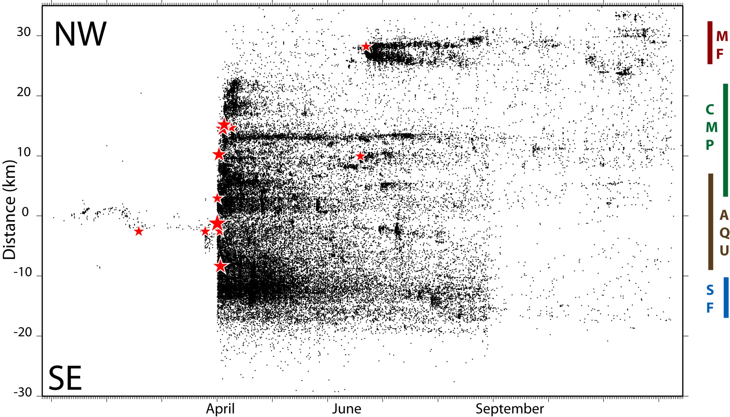
Time Window 2: Jan-March 29th
INGV
Space-time evolution

Slide 17
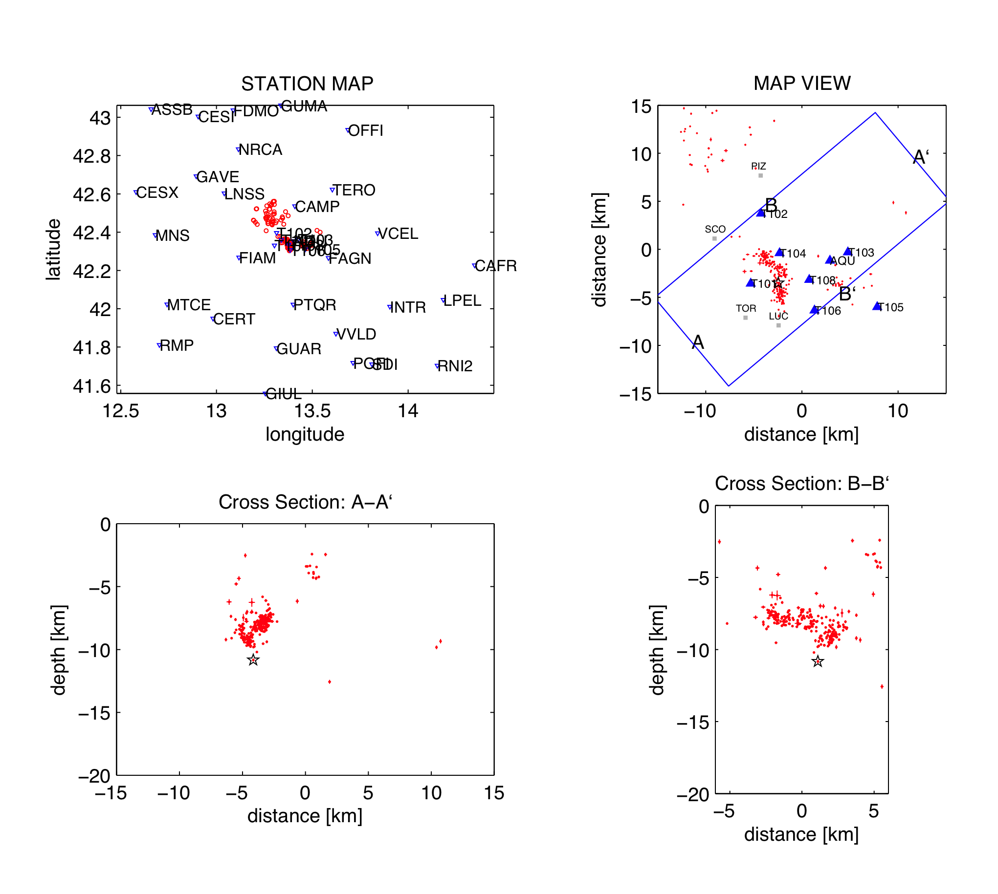
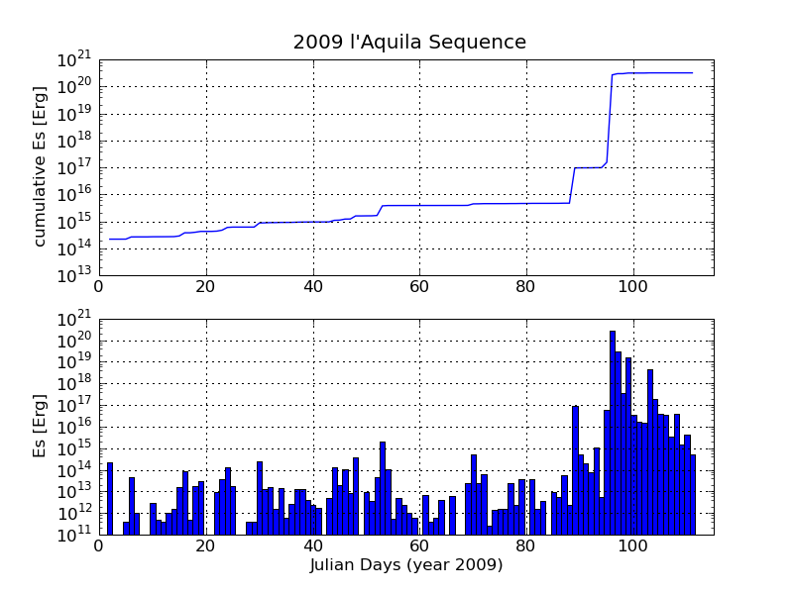
Time Window 2: Jan-March 29th
INGV

Slide 18
Time Window 2: Jan-March 29th
INGV
What we did & What happened
We followed the evolution of seismicity through the permanent national seismic network, which has a completeness magnitude in that area is M_{c} ≈ 1.4. Data were (/ are) available in real time on the INGV website
We released to the Italian Civil Protection several official reports stating that we cannot predict earthquakes and that the available information does not allow us to make any statement concerning impelling large-magnitude earthquakes, but does not allow us to exclude it, due to the high seismic hazard of the area and the seismic history of the city
We used the official procedure to communicate in real time to DPC earthquakes, magnitudes, locations and nearest struck villages
On March 29th Mr. G. Giuliani, a technician at the Gran Sasso National Laboratory, predicts and broadcasts the occurrence of a large magnitude event in Sulmona (60 km far away from L’Aquila). He relied on indirect measures of radon emission.

Slide 19
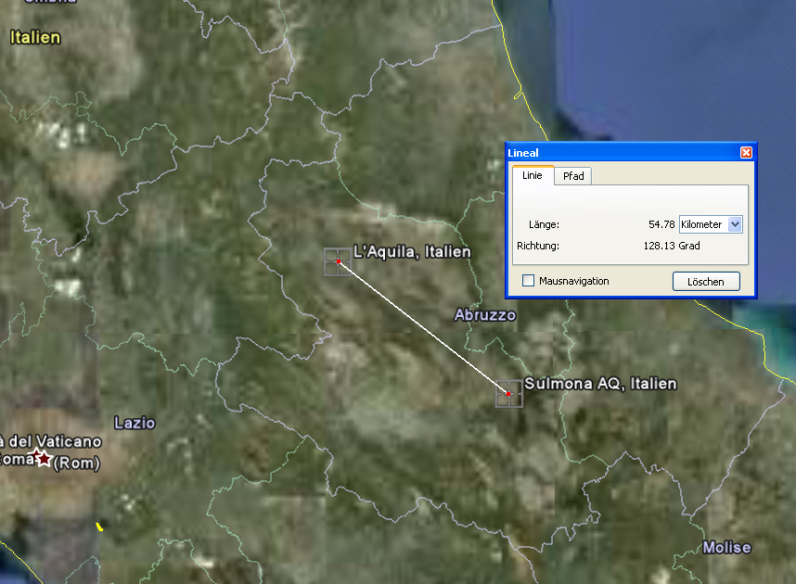
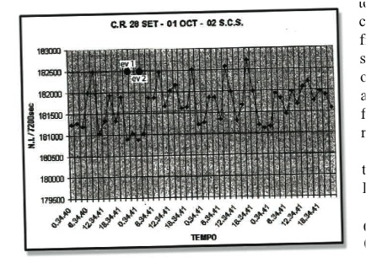
The RADON precursor: Prediction claim
Prediction claim by Giampaolo Giuliani (Laboratori Nazionali del Gran Sasso) based on radon emission
Broadcasted March 29th
“Earthquake will happen in 6-24 hours”
Region: Sulmona
Distance: 60km
An example of prediction:
  More than 15 peaks in 3 days.
  Two events of moderate magnitude
  claimed to be predicted
  No correlation between amplitude
  of the peaks and earthquakes.

Slide 20
Time Window 2: Jan-March 29th
INGV
What we might have done a posteriori
We can better calibrate our statements trying to find the difficult equilibrium between avoiding to reduce the risk perception and avoiding to create unjustified panic.
In both cases, we must release our information in a transparent and open way, in full awareness that the impact on society depends on preparedness and education
We should strengthen reminders to adopt prevention strategies, although this is not the main duty of scientists
We should develop a strategy to manage earthquake prediction statements (managing the “silver bullets approach”)

Slide 21
Conclusions 2
INGV
The lack of preparedness and education of population reduced the effect of authoritative information released by scientists
The impact of media interest on the claimed prediction created misleading expectations from society
It has been argued that the seismic sequence started on January 2009 could have been considered as “precursor”, but there was not corroborated evidence to support such a statement and to deliver a warning to decision makers
Although we agree that any earthquake in principle can increase the probability to have a subsequent large event, difficulties exist to use and disseminate such an information to society (also because the values remain low and false alarms are expected)

Slide 22
Time Window 3: March 30th – April 5th
INGV
The rate of earthquake production increased on March 30th 2009 after a M_{L} 4.1 earthquake that struck the L’Aquila area
Preoccupation and panic in population raised
After a prediction broadcasted by Giuliani, vans mounted with loudspeakers blare warnings to Sulmona residents to flee. Many people do. No earthquake occurs in the prediction window.
On March 31st the Italian Civil Protection organize in L’Aquila a meeting of the Commissione Grandi Rischi (Major Risks Committee), an expert group that advises the Civil Protection agency on the risks of natural disasters
Immediately after that meeting, De Bernardinis and Barberi, acting president of the committee, held a press conference in L’Aquila, where De Bernardinis told reporters that “the scientific community tells us there is no danger, because there is an ongoing discharge of energy. The situation looks favorable”.

Slide 23
Time Window 3: March 30th – April 5th
INGV
Space-time evolution

Slide 24
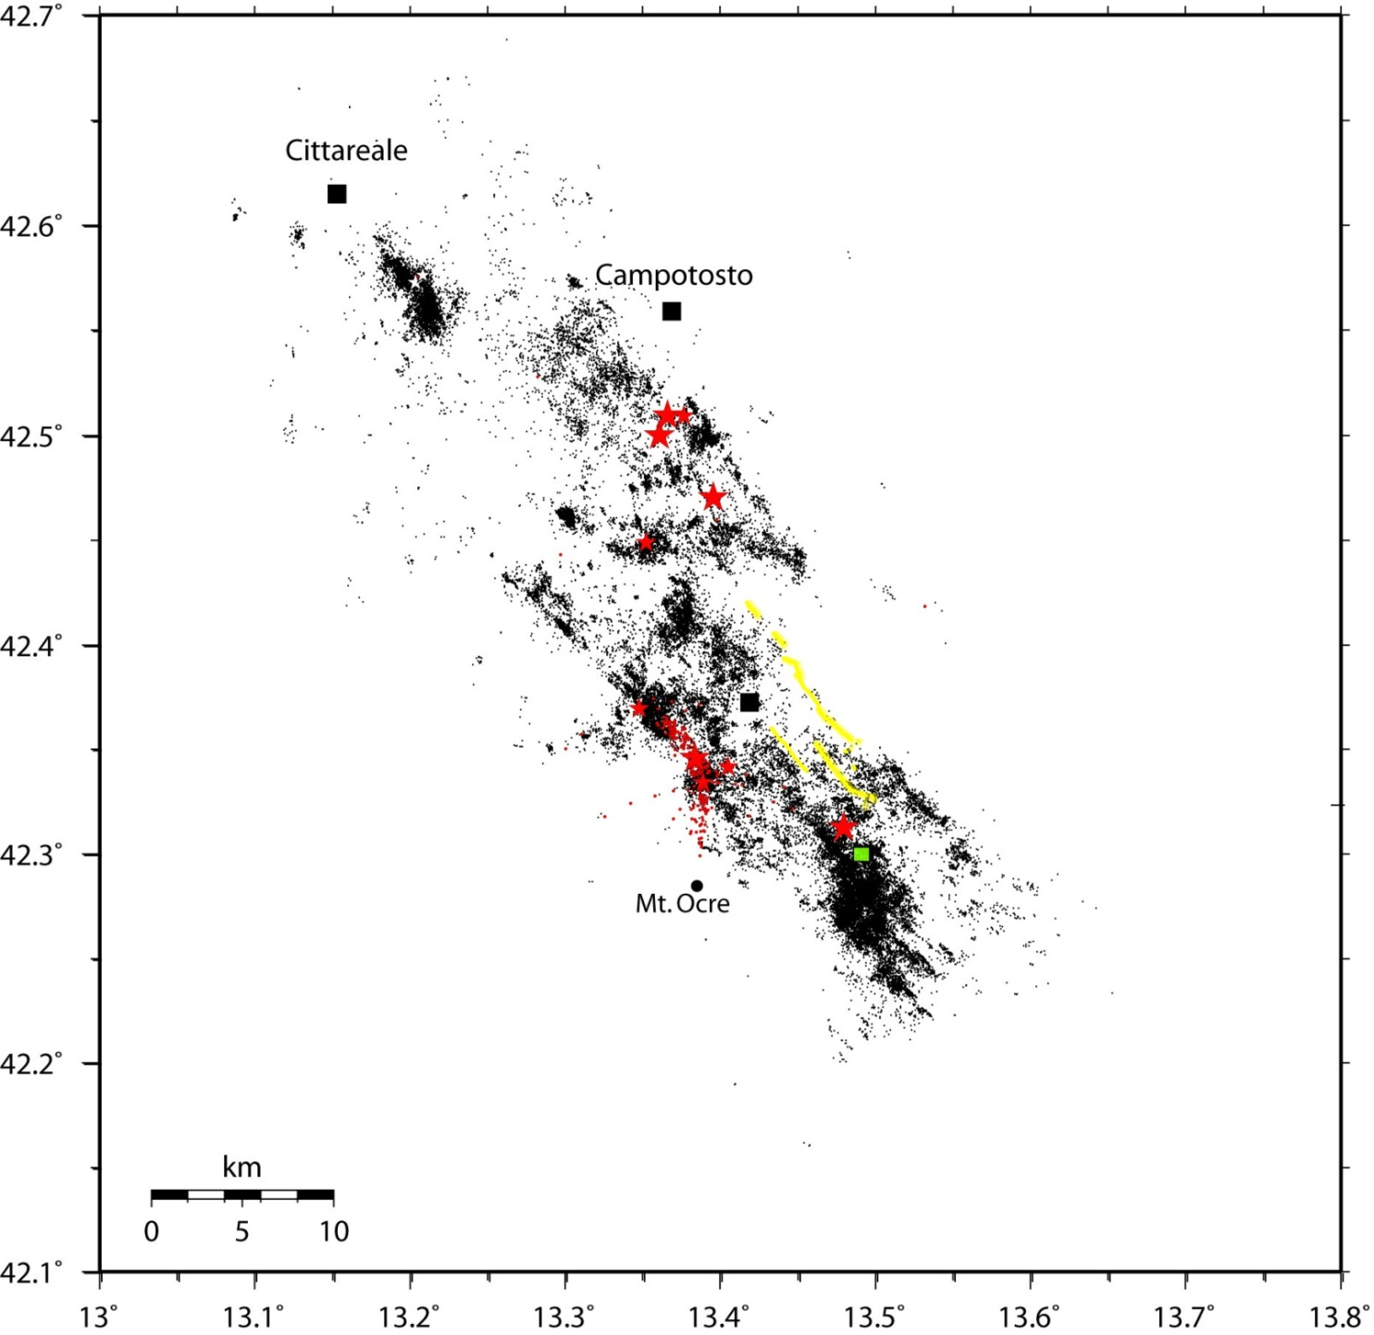
the foreshocks sequence
Notes:
Zoom in the epicentral area for some weeks across March-April 2009.

Slide 25
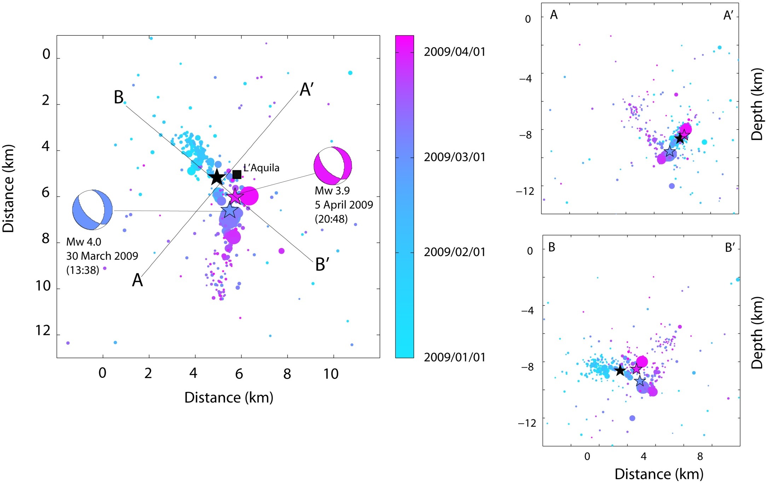
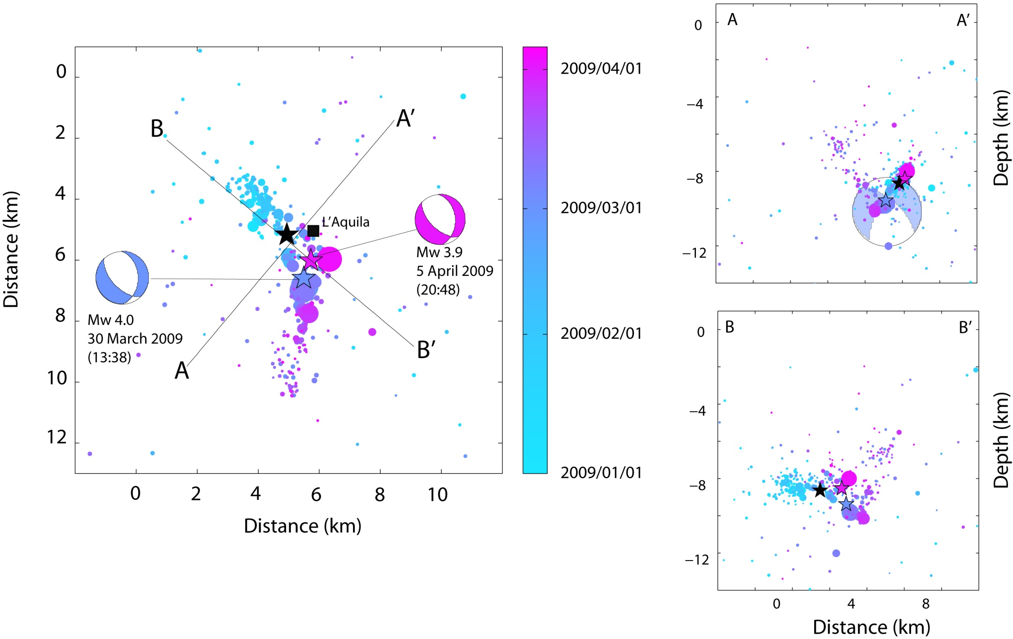
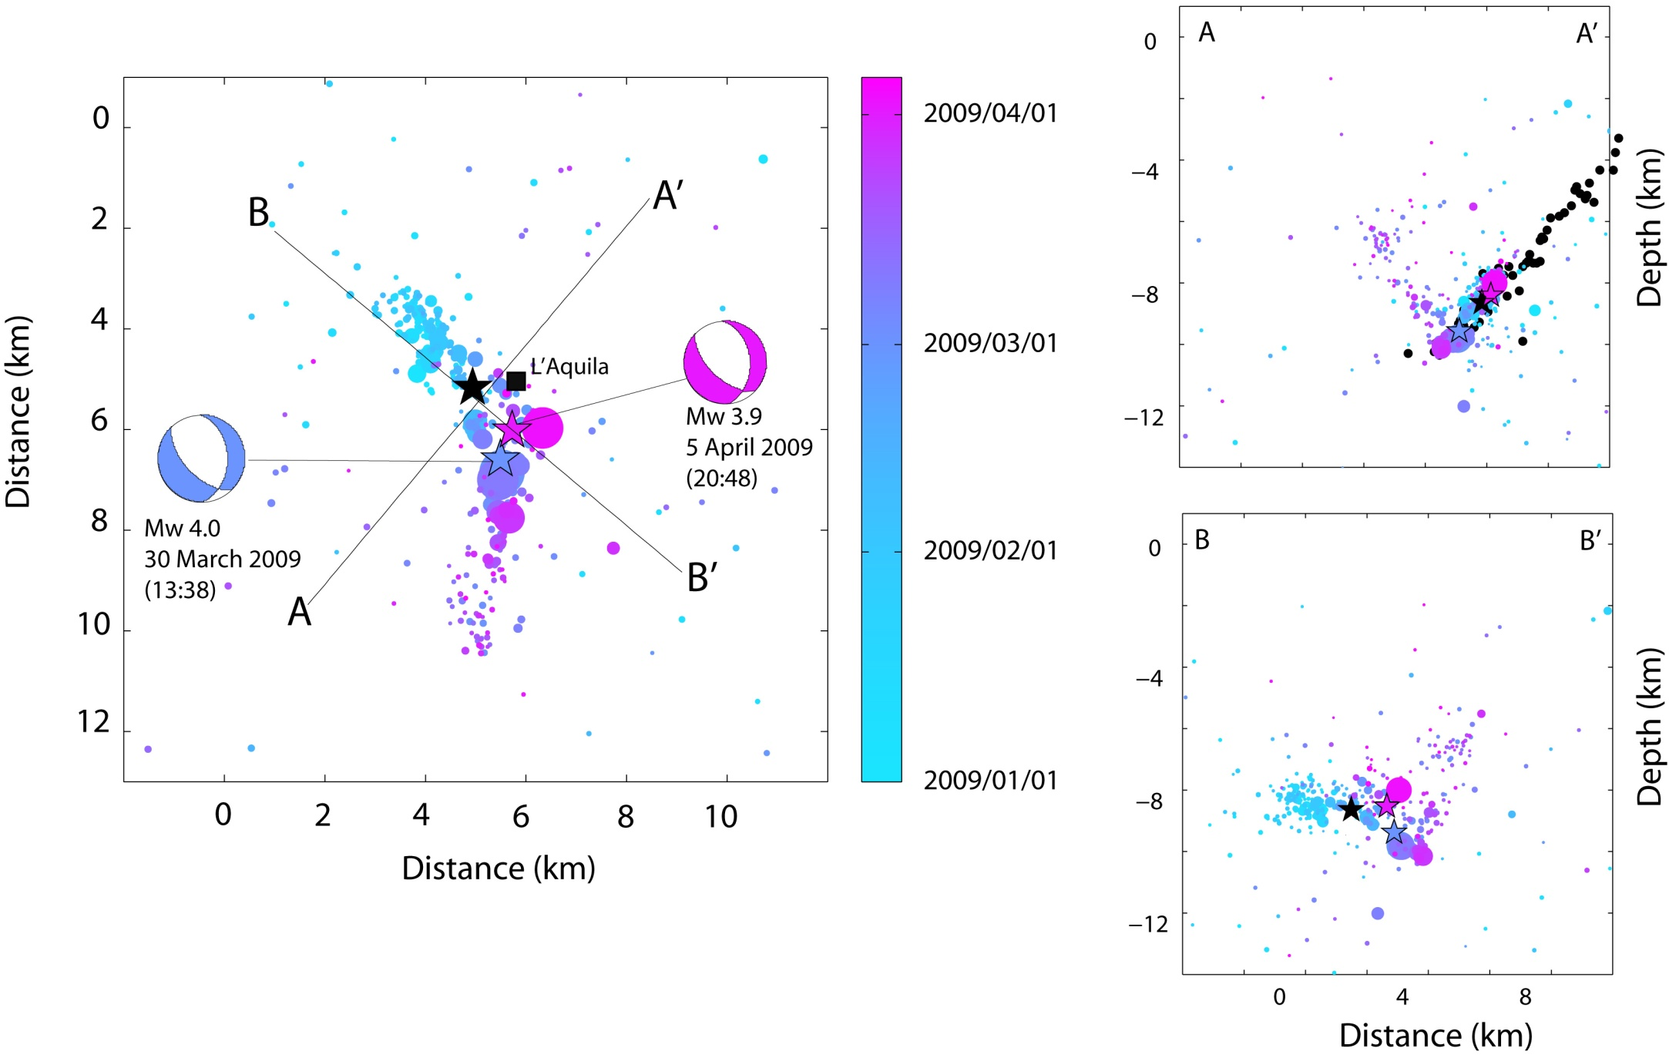
the foreshocks sequence
(Chiaraluce et al., 2011)

Slide 26
Time Window 3: March 30th – April 5th
INGV
In the period 2008-2010 Mele et al. (2010) identify 127 seismic sequences in Italy and verify that nearly 70% of seismicity belongs to sequences, having very different durations and patterns. 1 out of 127 is followed by a destructive event.
INGV experts have analyzed all the available data and prepared a report to be presented by Giulio Selvaggi at the CGR meeting
On March 31st Commissione Grande Rischi issues statement: “There is no reason to say that the sequence of events of low magnitude can be considered precursory to a strong event.” Italian authorities tell Giuliani that he was panicking an already jittery population and not to publicize further predictions.
On April 1st DPC head Bertolaso asks the population to be calm. De Bernardinis says “Taking into account the scientific knowledge on this seismic swam, we do not expect an increase in the earthquake magnitude .“ Sequence intensifies.

Slide 27
Conclusions 3
INGV
We can confirm that there were no reasons to say that the sequence of events of low magnitude could be considered a precursory to a strong event.
The complex spatial pattern of foreshocks further inhibits to make any statement concerning evidence of the nucleation process of a moderate-to-large magnitude earthquake
There were misleading declarations by official decision makers concerning the lack of immediate risk and aimed at keeping calm population
It was evident the lack of any shared communication strategy between scientists, governmental agencies and media dedicated to provide authoritative and validated information to public

Slide 28
Time Window 4: April 6th & aftershocks
INGV
What we did
Immediately after the main shock of April 6th INGV experts provided all the available information to the Italian Civil Protection to manage the emergency and plan the intervention
Several official INGV statements said that: “in recent times some recent earthquakes have been preceded by minor shocks days or weeks beforehand, but on the other hand many seismic swarms did not result in a major event”
On April 7th INGV issues its first 24-hr aftershock forecast at 8:00 am, about 15 hrs after

Slide 29
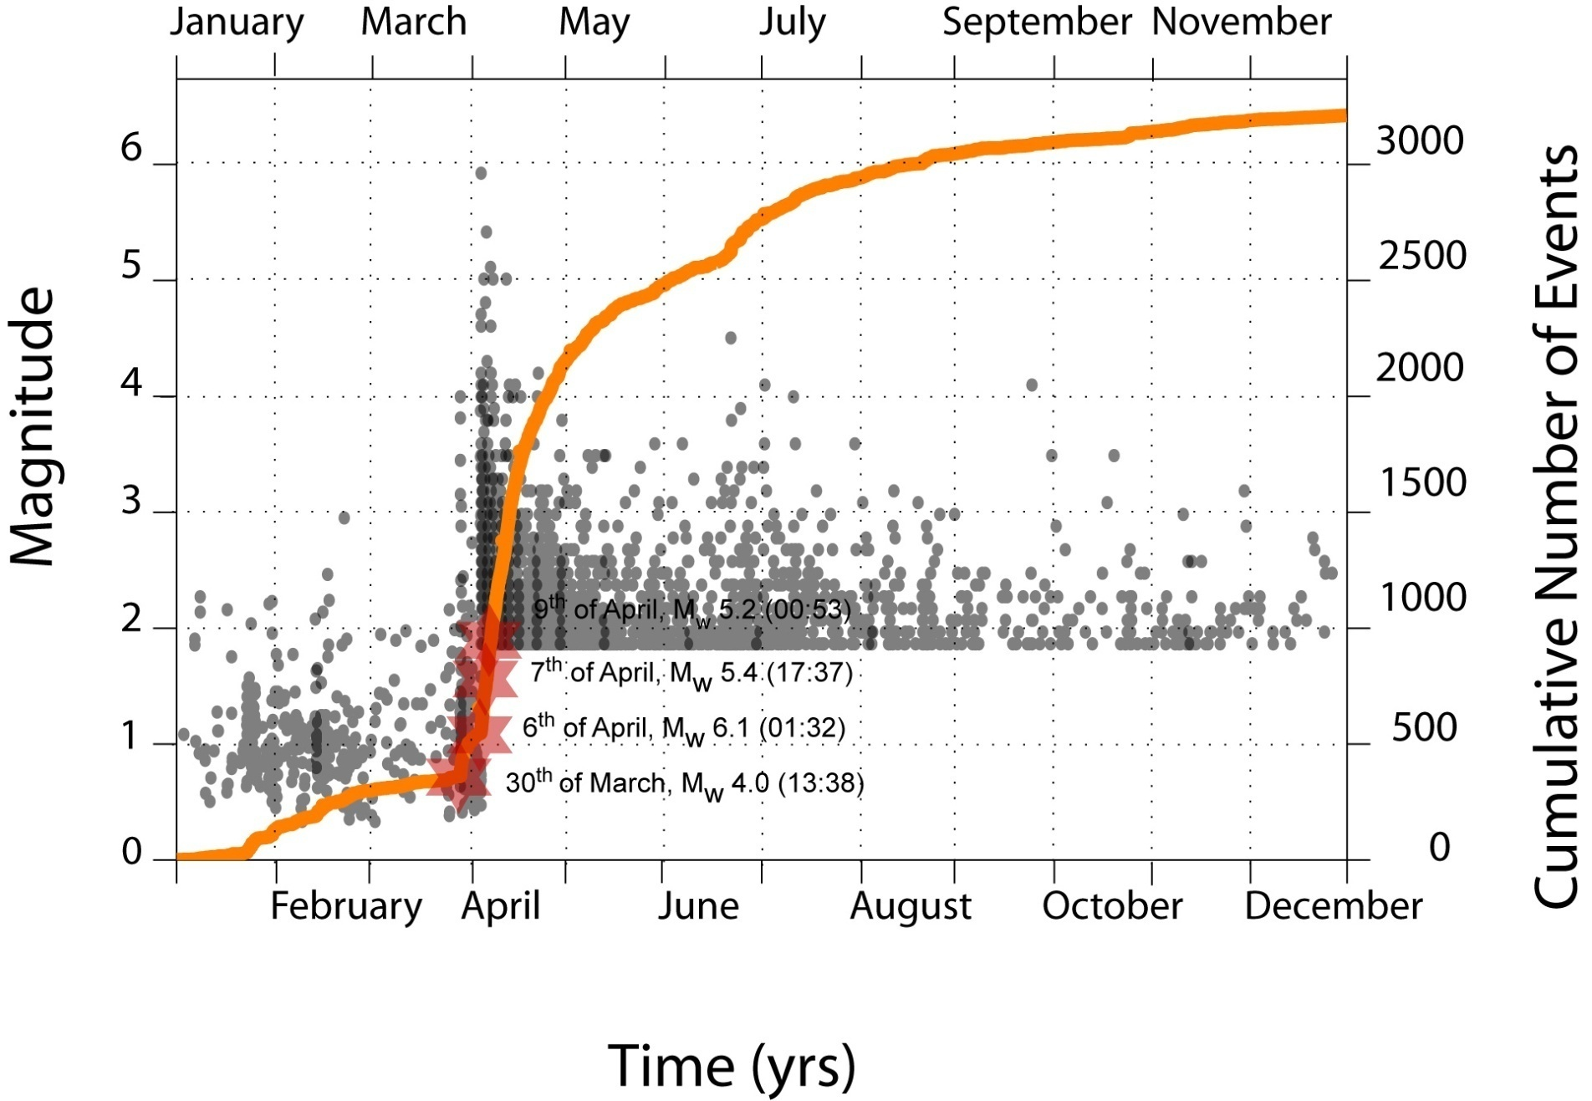
Time Window 4: April 6th & aftershocks
INGV
Omori law (1894)
N (t) = K / c + t

Slide 30
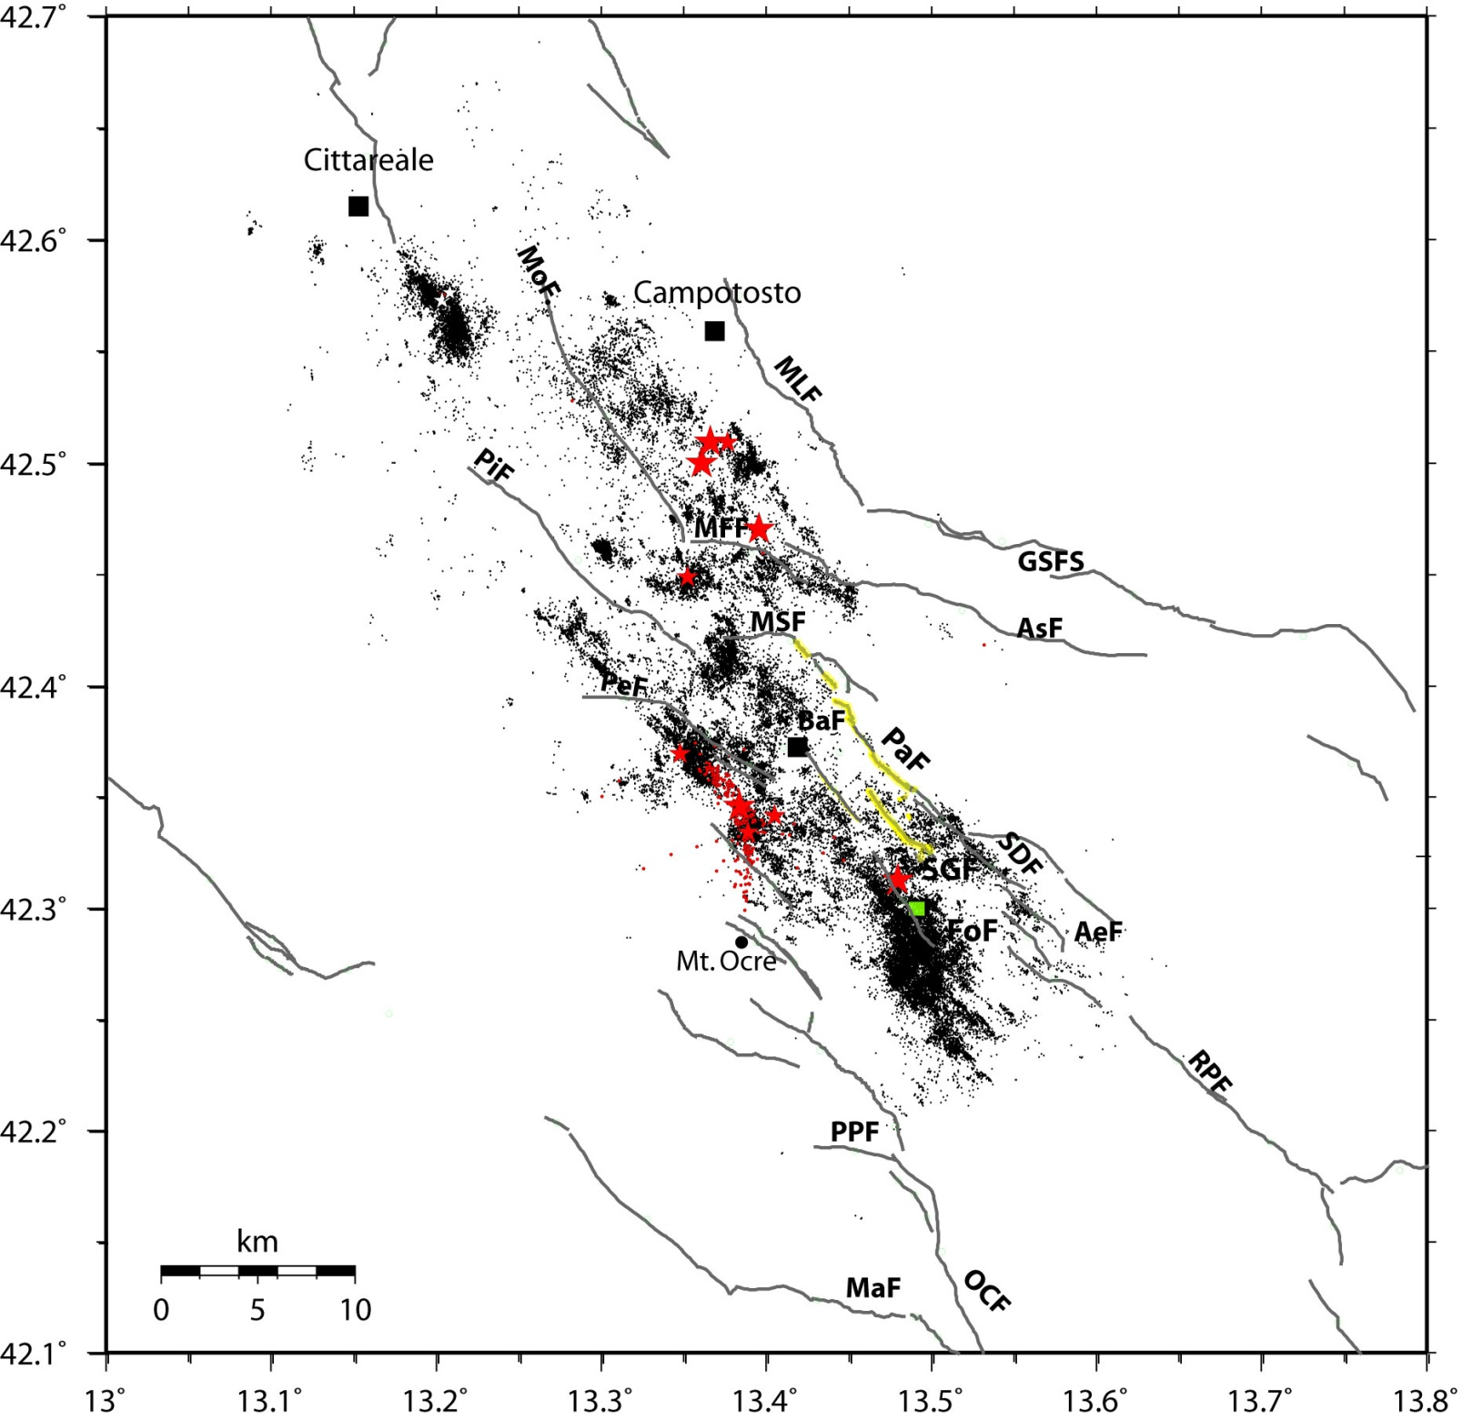
Time Window 4: April 6th & aftershocks
INGV

Slide 31
Time Window 4: April 6th & aftershocks
INGV
What happened
The ML 5.8 Mw 6.3 earthquake killed 309 persons, 1.600 were injured and 65.000 homeless
In August 2009 several citizens filed a formal request asking a prosecutor to investigate.
L’Aquila’s chief prosecutor was confined to proceed with an investigation and on June 2011 he considered to have gathered the necessary information to indict the individuals named.
Seven Italian scientists and government officials are nowadays under investigation on charges of manslaughter for failure to warn the city of L’Aquila, Italy, before the earthquake.
The minutes of the 31 March meeting reveal that at no point did any of the scientists say that there was “no danger” of a big quake. “A major earthquake in the area is unlikely but cannot be ruled out,”

Slide 32
Solidarity and Criticisms
INGV
INGV scientists signed a letter of solidarity with Boschi and Selvaggi. Seismologists worldwide have also rallied to the defence of the scientists, with almost 4,000 researchers from 100 different countries signing a letter to Giorgio Napolitano, Italy’s president, urging decision-makers to concentrate on “earthquake preparedness and risk mitigation rather than on prosecuting scientists for failing to do something they cannot do yet — predict earthquakes”.
The motivations for the prosecution at that time justified that letter.
However, several scientists and public criticized our decision to write such a letter of support.
Before the great 2011 Tohoku earthquake, Japanese scientists were studying the L’Aquila prosecution as a potential danger for their work

Slide 33
Conclusions 4
INGV
This earthquake has left the scientific community and the involved stakeholders quite evident lessons concerning the necessary prevention actions, as well as the urgent need to train and educate the society to live in earthquake prone areas.
These lessons should spur all the public authorities towards a better use of seismic hazard maps and available information concerning the vulnerability of the Italian territory
These lessons demand for urgent initiatives to increase the resilience of the Italian society to natural hazards.
Unfortunately, these lessons are still unheard.
It is in the best interest of all countries to reduce earthquake vulnerability through awareness, preparation, and mitigation.

Slide 34
Conclusions 5
INGV
The missed prediction and the claimed lack of adequate indications for evacuating the population immediately before the earthquake have focused the attention of the media and produced a misleading effect on public opinion.
There was the presumption to undertake prevention actions in few days or hours without any existing plan for emergency management.
There was the presumption to do in few days what it was not done in previous decades or years.
The responsibility of local authorities and administrators is not discussed and considered.
No responsibility for not doing in the 10 years preceding the earthquake any minimal prevention action

Slide 35
Conclusions 6
INGV
Prosecutors and the families of victims say that the trial has nothing to do with the ability to predict earthquakes, and everything to do with the failure of government-appointed scientists serving on an advisory panel to adequately evaluate, and then communicate, the potential risk to the local population.
Not all the indicted scientists are government-appointed!
The decision to stay in a building during an earthquake sequence should be determined by the awareness to live in a safe construction built or reinforced to resist to earthquakes and respecting the building codes.
Personally, I would not rely on any statement from scientists or decision-makers, without such a precondition.

Slide 36
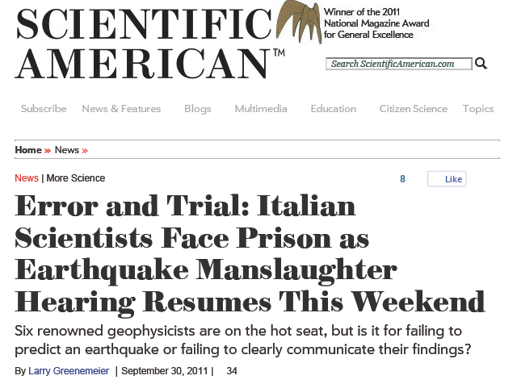
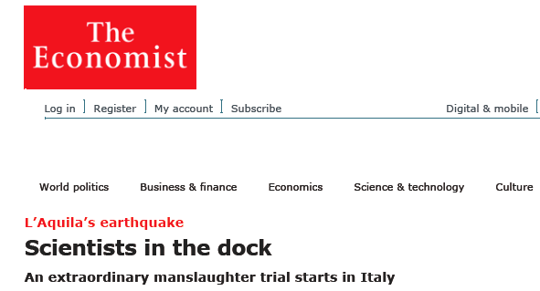
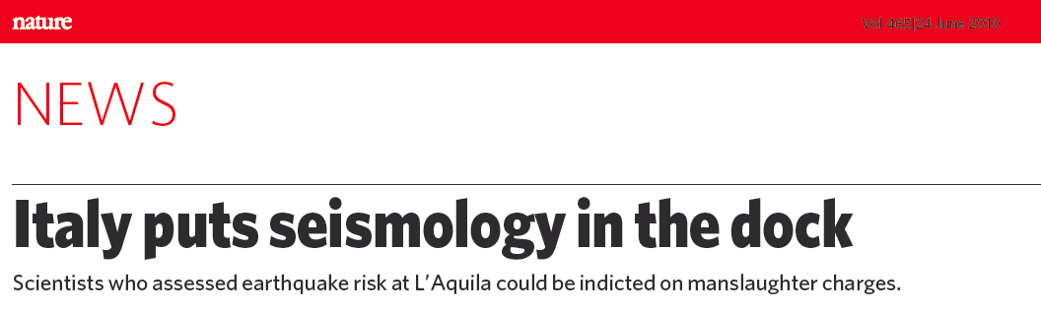
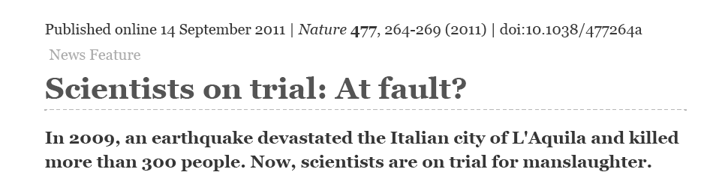

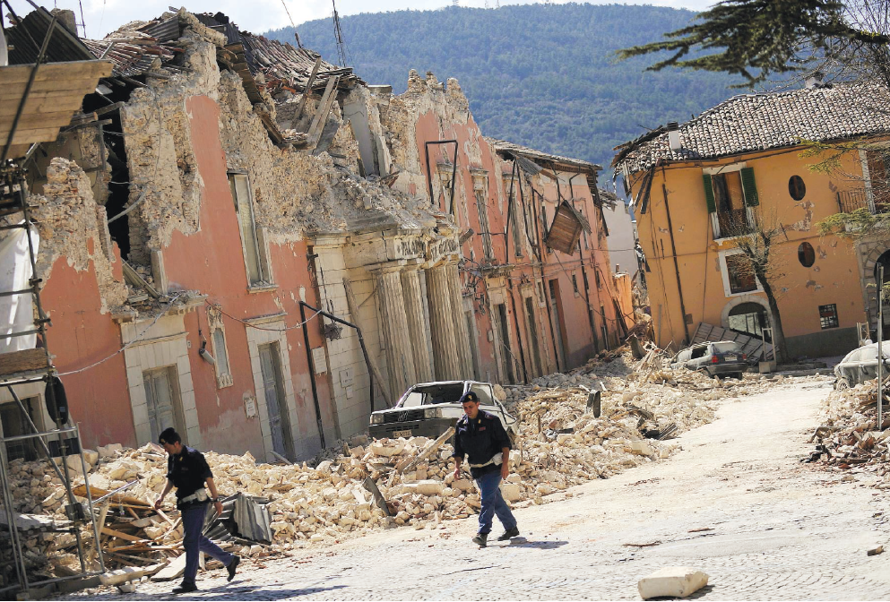
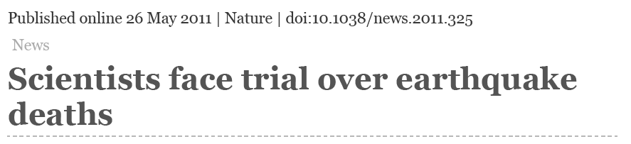
People were not killed by the missed prediction
People were not killed by bad hazard maps
Earthquake Risk in L’Aquila was not unknown

